Slide 1
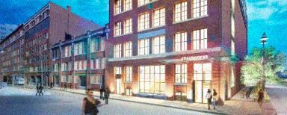
Fraunhofer | Center for Sustainable Energy
Boston, MA
Schematic Lighting Design
Xiaoyin Wu
2013.12.09

Slide 2
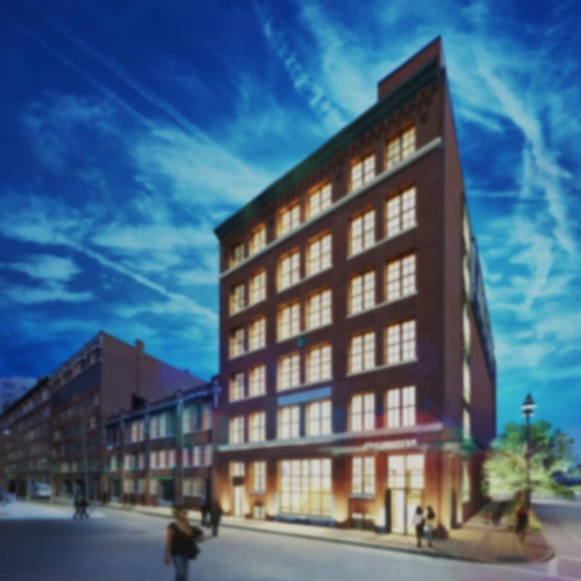
building | concept | four spaces | design solutions
Fraunhofer CSE | Boston, MA | Schematic Design | Xiaoyin Wu

Slide 3
building | concept | four spaces | design solutions
Project Overview
Building Name-
Location-
Occupancy Type-
Size-
Stories above Grade-
Project Teams-
Fraunhofer CSE
5 Channel Center Street, Boston, MA
Offices and research laboratories (Group B)
Conference room (Group A-3)
42150SF
6
General Contractor: Gilbane Building Co.
Architects: DiMella Shaffer
Structural Engineer: McNamara/Salvia, Inc.
MEP/FP/Tel Data Engineer: BR+A Consulting Engineers
Lighting Consultant: Lam Partners
Plumbing/HVAC Services: Northeastern Mechanical
Fraunhofer CSE | Boston, MA | Schematic Design | Xiaoyin Wu

Slide 4
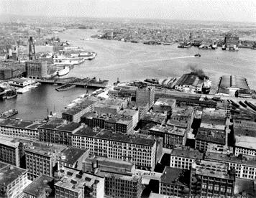
building | concept | four spaces | design solutions
Architecture
a renovation for a 100-year old historical building classical revival-style detailing
the Fort Point Channel district is marked by an exceptional degree of visual uniformity
buildings are elegantly proportioned, with classically inspired details concentrated at entrances and cornices the structure is left unchanged in this project to conserve the significant continuity throughout the District in terms of massing, scale, and style
Fraunhofer CSE | Boston, MA | Schematic Design | Xiaoyin Wu

Slide 5
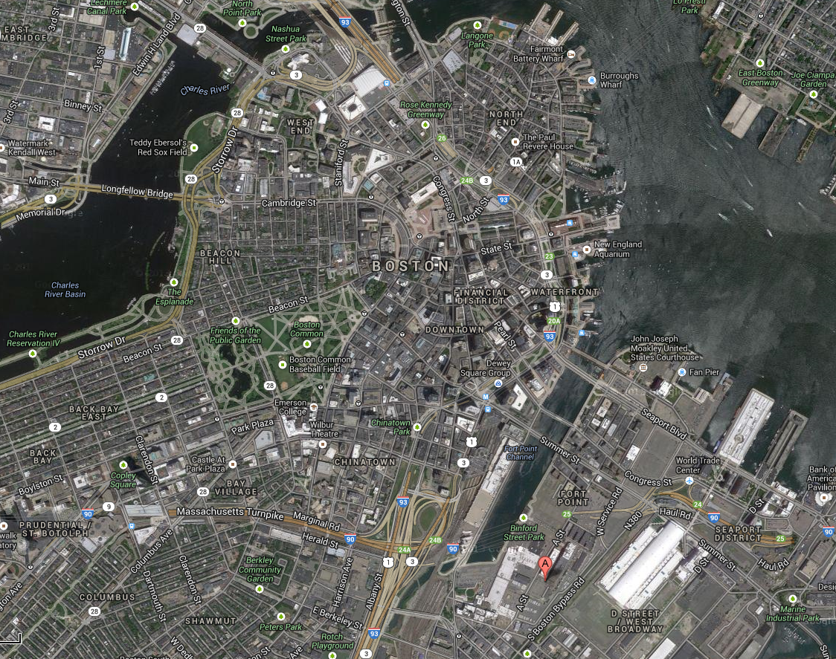
building | concept | four spaces | design solutions
Fraunhofer CSE | Boston, MA | Schematic Design | Xiaoyin Wu

Slide 6
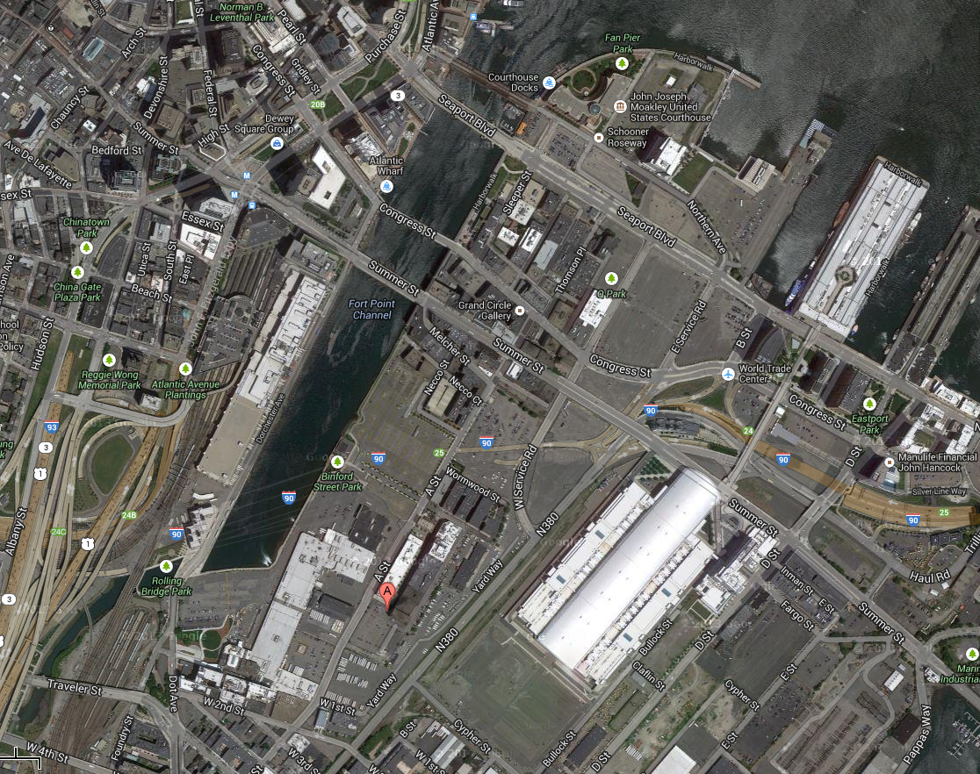
building | concept | four spaces | design solutions
Fraunhofer CSE | Boston, MA | Schematic Design | Xiaoyin Wu

Slide 7
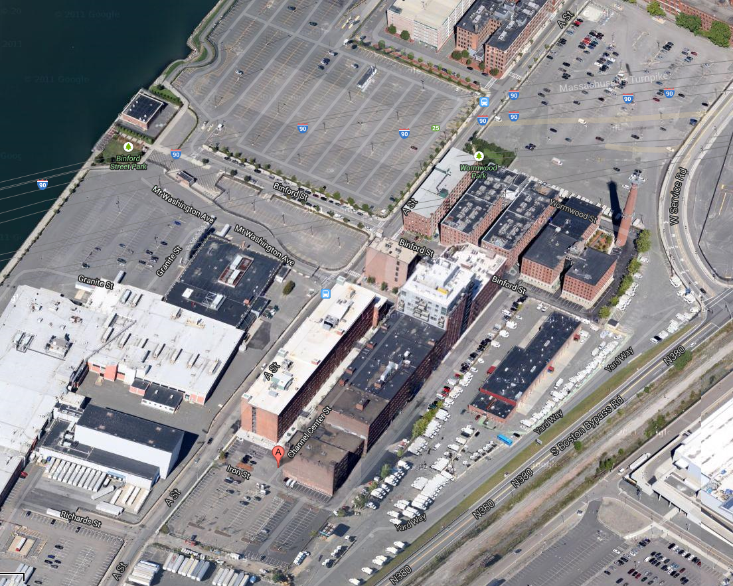
building | concept | four spaces | design solutions
Fraunhofer CSE | Boston, MA | Schematic Design | Xiaoyin Wu

Slide 8
building | concept | four spaces | design solutions
Based in Boston, MA, the Fraunhofer Center for Sustainable Energy Systems (CSE) is an applied research and development laboratory dedicated to the commercialization of CLEAN energy TECHNOLOGIES. CSE engages in COLLABORATIVE research and development with private companies, government entities, and academic institutions, performing research that broadly benefits firms, industries, and society.
Fraunhofer CSE | Boston, MA | Schematic Design | Xiaoyin Wu

Slide 9
building | concept | four spaces | design solutions
clean—SIMPLICITY
Based in Boston, MA, the Fraunhofer Center for Sustainable Energy Systems (CSE) is an applied research and development laboratory dedicated to the commercialization of CLEAN energy TECHNOLOGIES. CSE engages in COLLABORATIVE research and development with private companies, government entities, and academic institutions, performing research that broadly benefits firms, industries, and society.
technology—INTELLIGENT
coordination—COLLABORATIVE
Fraunhofer CSE | Boston, MA | Schematic Design | Xiaoyin Wu

Slide 10
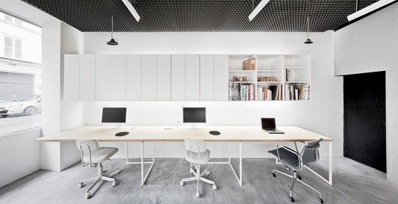

building | concept | four spaces | design solutions
Clean | Simplicity
Fraunhofer CSE | Boston, MA | Schematic Design | Xiaoyin Wu

Slide 11

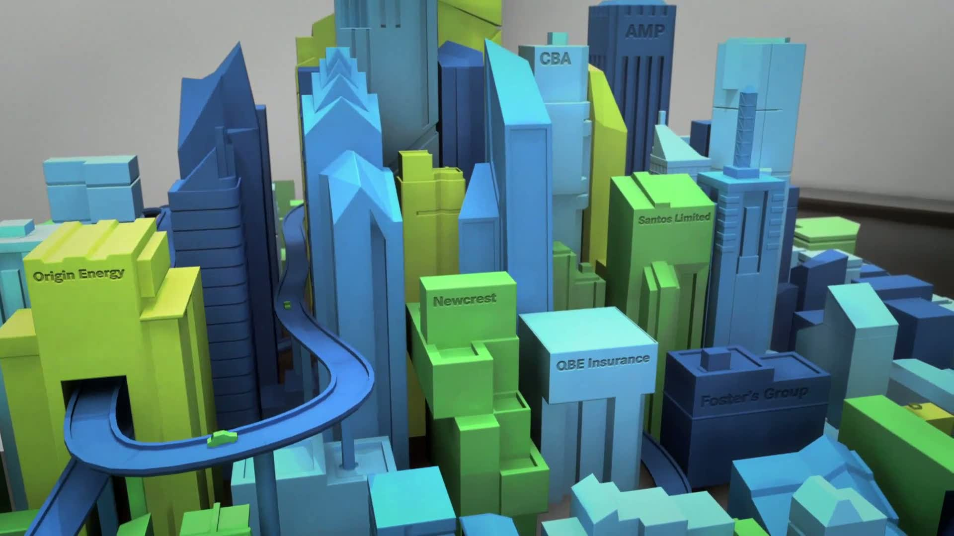
building | concept | four spaces | design solutions
Technology | Intelligent
Fraunhofer CSE | Boston, MA | Schematic Design | Xiaoyin Wu

Slide 12


building | concept | four spaces | design solutions
Coordination | Collaborative
Fraunhofer CSE | Boston, MA | Schematic Design | Xiaoyin Wu

Slide 13
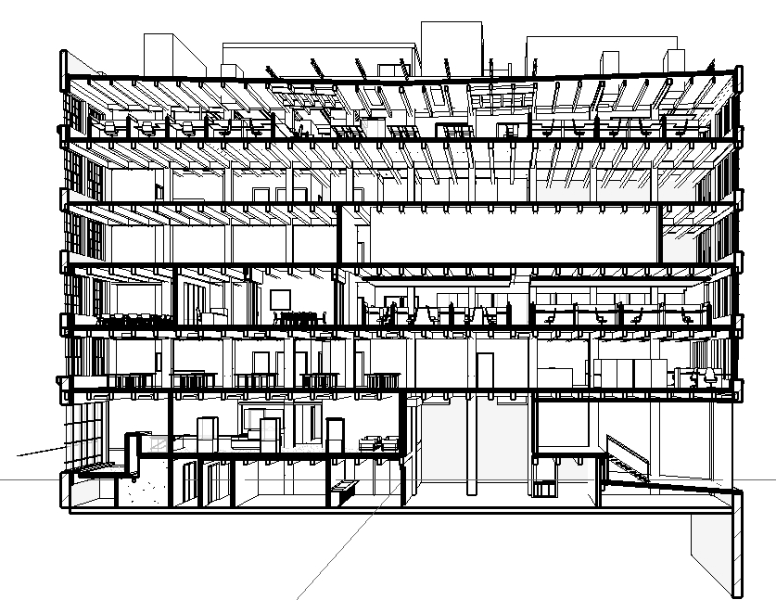
building | concept | four spaces | design solutions
Spaces
Façade
Office
Lobby &
Conference Room
Fraunhofer CSE | Boston, MA | Schematic Design | Xiaoyin Wu

Slide 14
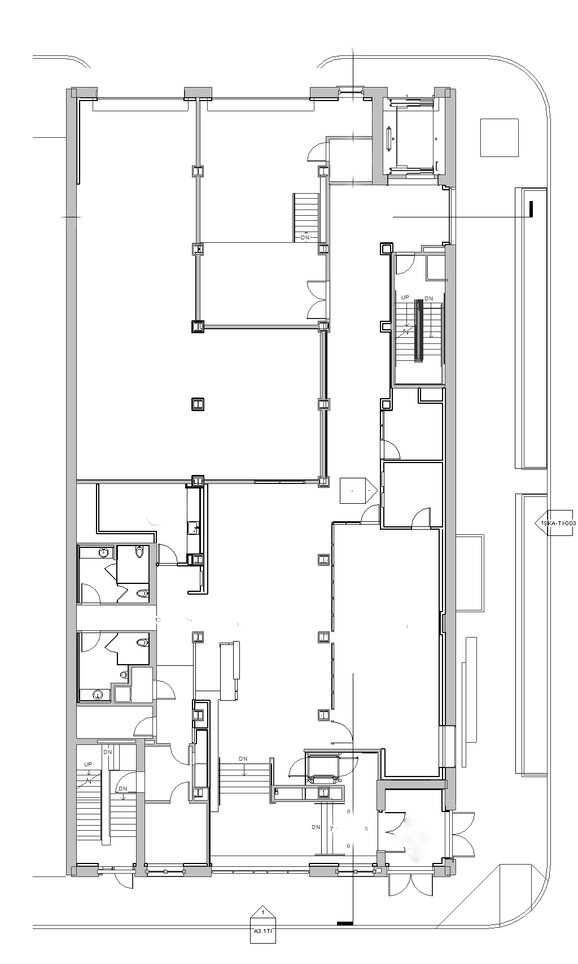
building | concept | four spaces | design solutions
1st Floor
Reception/Lobby
Conference Room
Fraunhofer CSE | Boston, MA | Schematic Design | Xiaoyin Wu

Slide 15
lobby | conference room | open office | façade
Criteria
Space |  | Eh | Ev | Avg:Min
Lower Lobby (F112) |  | 100 lux | 30 lux | 4:1
Upper Lobby (F113) | Reception Desk | 150 lux | 50 lux | 4:1
 | General Area | 100 lux | 30 lux | 4:1
Professional
Modern
Technology Oriented
Fraunhofer CSE | Boston, MA | Schematic Design | Xiaoyin Wu

Slide 16
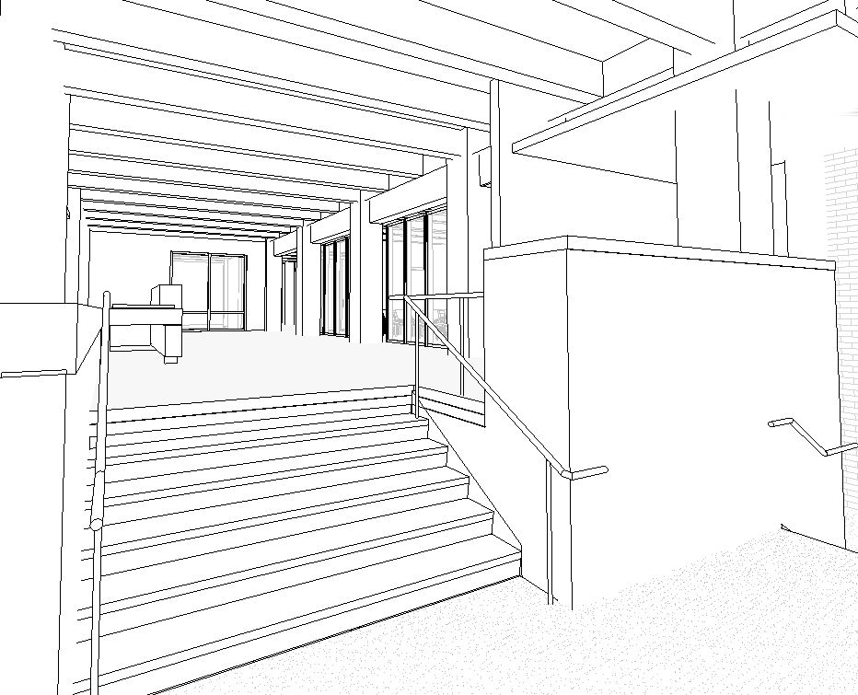
lobby | conference room | open office | façade
Lobby | Reception
Fraunhofer CSE | Boston, MA | Schematic Design | Xiaoyin Wu

Slide 17
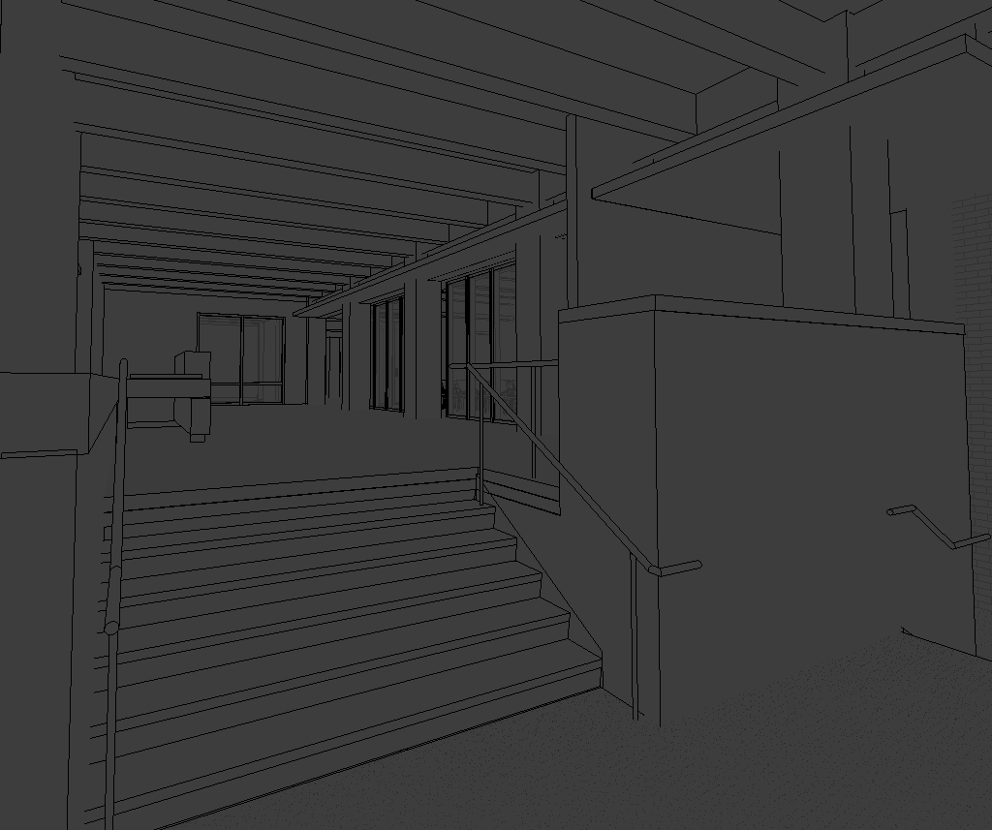
lobby | conference room | open office | façade
Lobby | Reception
Fraunhofer CSE | Boston, MA | Schematic Design | Xiaoyin Wu

Slide 18
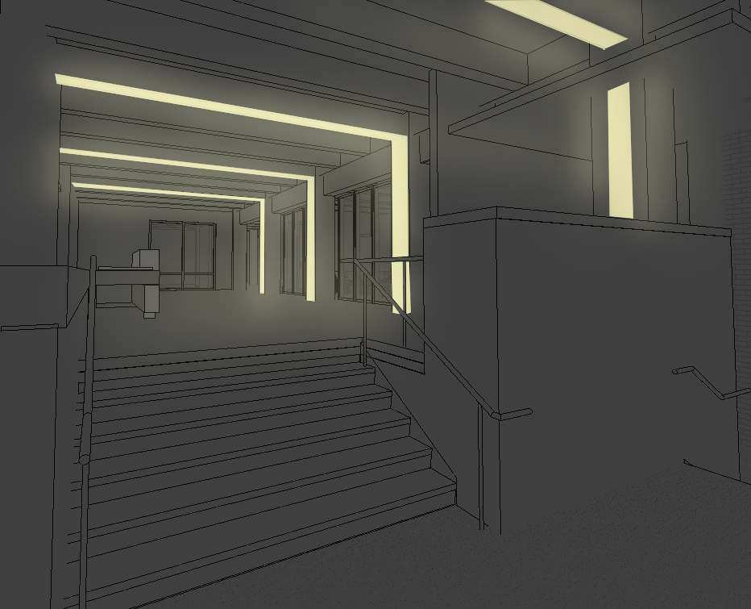
lobby | conference room | open office | façade
Lobby | Reception
Fraunhofer CSE | Boston, MA | Schematic Design | Xiaoyin Wu

Slide 19
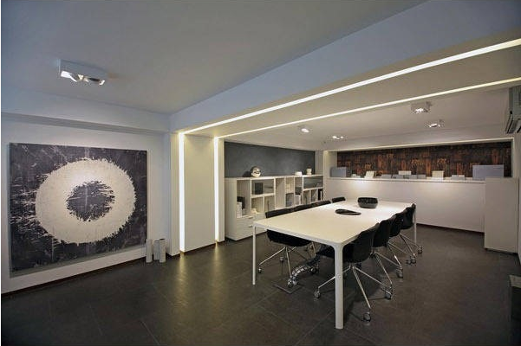
lobby | conference room | open office | façade
Lobby | Reception
Fraunhofer CSE | Boston, MA | Schematic Design | Xiaoyin Wu

Slide 20
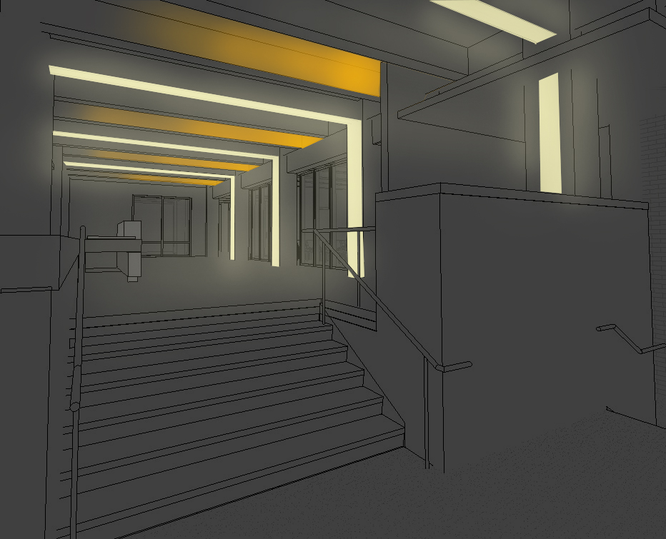
lobby | conference room | open office | façade
Lobby | Reception
Fraunhofer CSE | Boston, MA | Schematic Design | Xiaoyin Wu

Slide 21
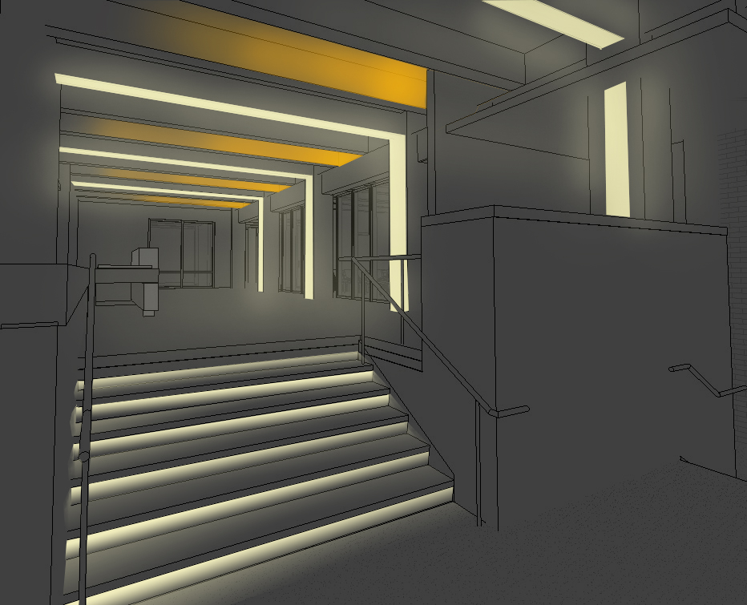
lobby | conference room | open office | façade
Lobby | Reception
Fraunhofer CSE | Boston, MA | Schematic Design | Xiaoyin Wu

Slide 22

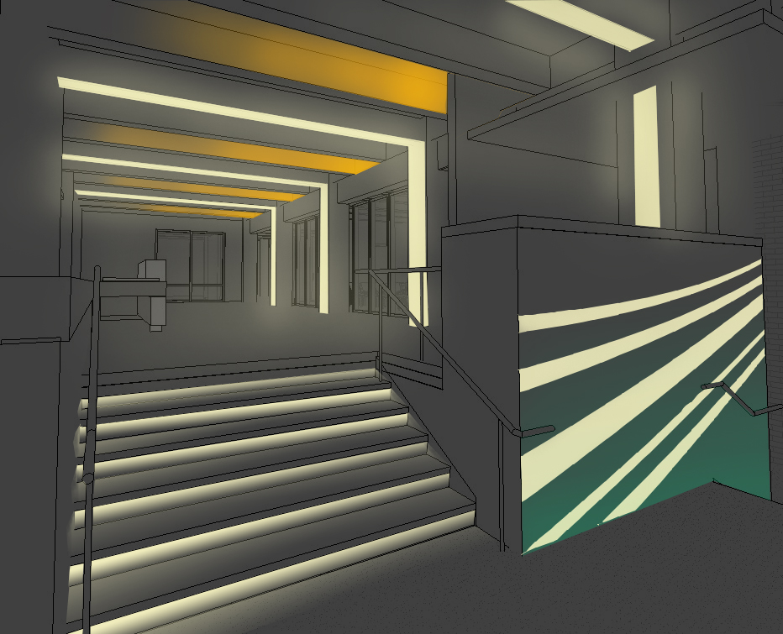
lobby | conference room | open office | façade
Lobby | Reception
Fraunhofer CSE | Boston, MA | Schematic Design | Xiaoyin Wu

Slide 23
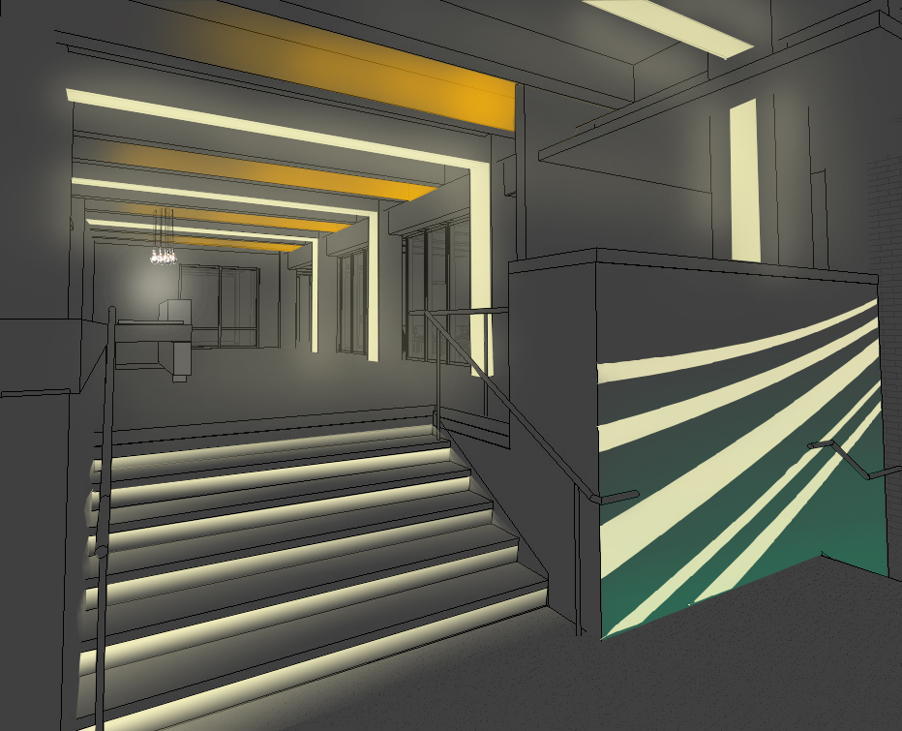
lobby | conference room | open office | façade
Lobby | Reception
Fraunhofer CSE | Boston, MA | Schematic Design | Xiaoyin Wu

Slide 24
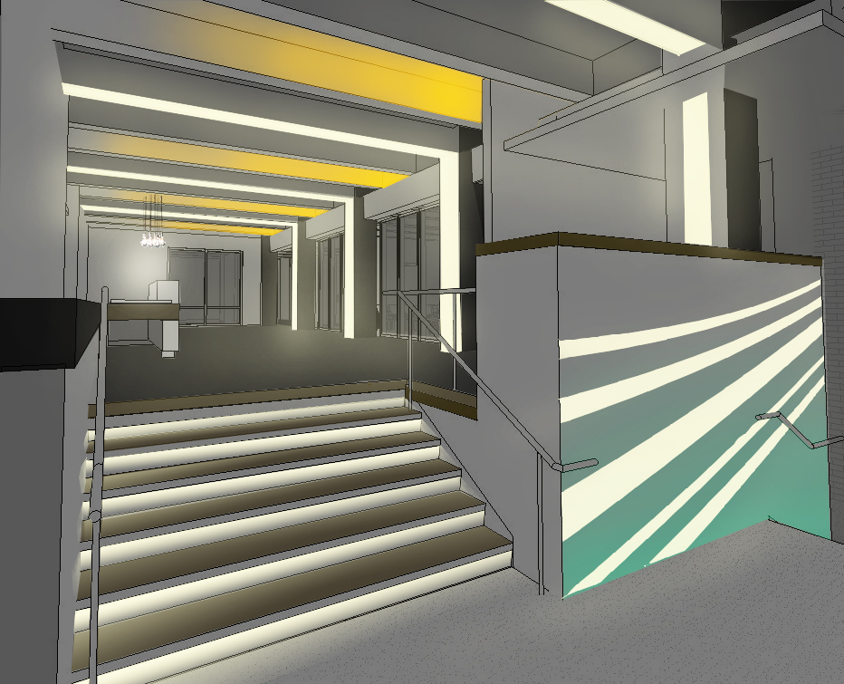
lobby | conference room | open office | façade
Lobby | Reception
Fraunhofer CSE | Boston, MA | Schematic Design | Xiaoyin Wu

Slide 25
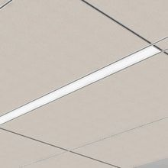
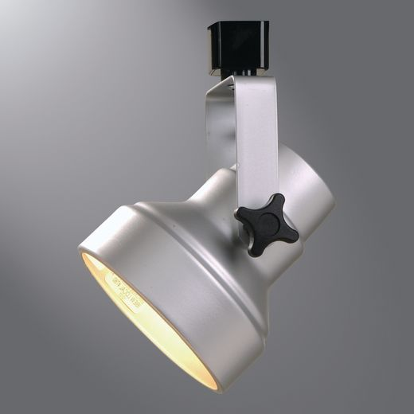
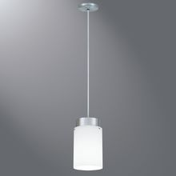
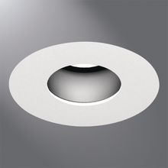
lobby | conference room | open office | façade
Lobby | Reception
Fraunhofer CSE | Boston, MA | Schematic Design | Xiaoyin Wu

Slide 26
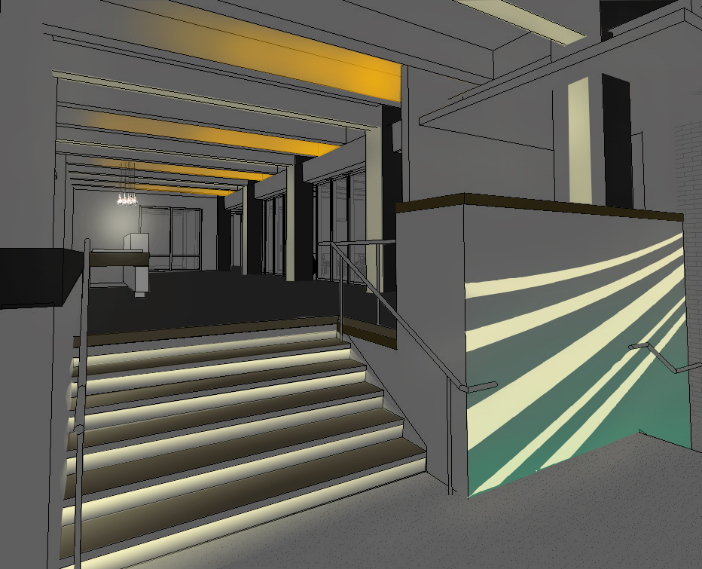
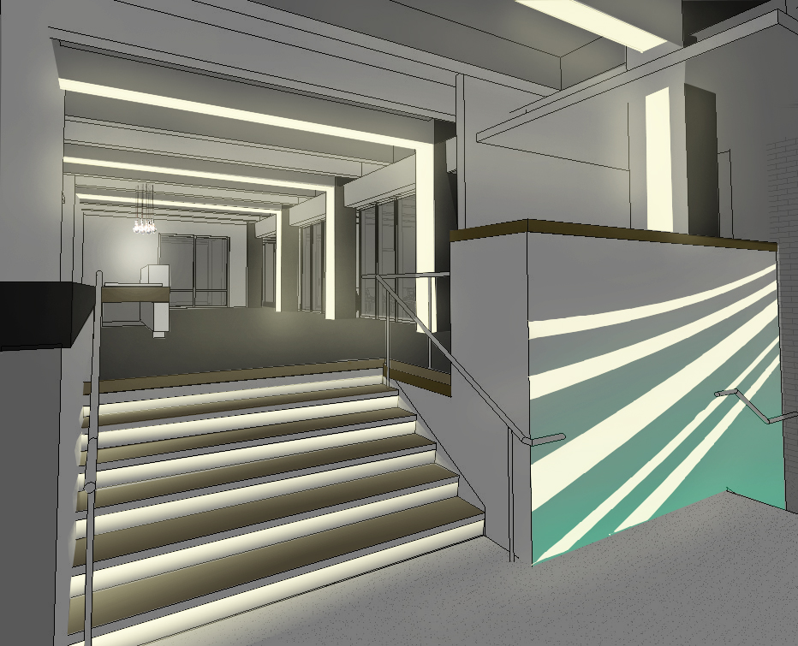
lobby | conference room | open office | façade
Lobby | Reception
Psychological impression:
relaxation | tension
Fraunhofer CSE | Boston, MA | Schematic Design | Xiaoyin Wu

Slide 27
lobby | conference room | open office | façade
Criteria
Surface/Purpose | Eh | Ev | Avg:Min
Meeting | 150 | 75 | 1.5:1
AV | 30 | 30
Front-screen projection |  | 50
Faces | 300 | 400 | 1.5:1
Professional
Simple
Task driven
Fraunhofer CSE | Boston, MA | Schematic Design | Xiaoyin Wu

Slide 28
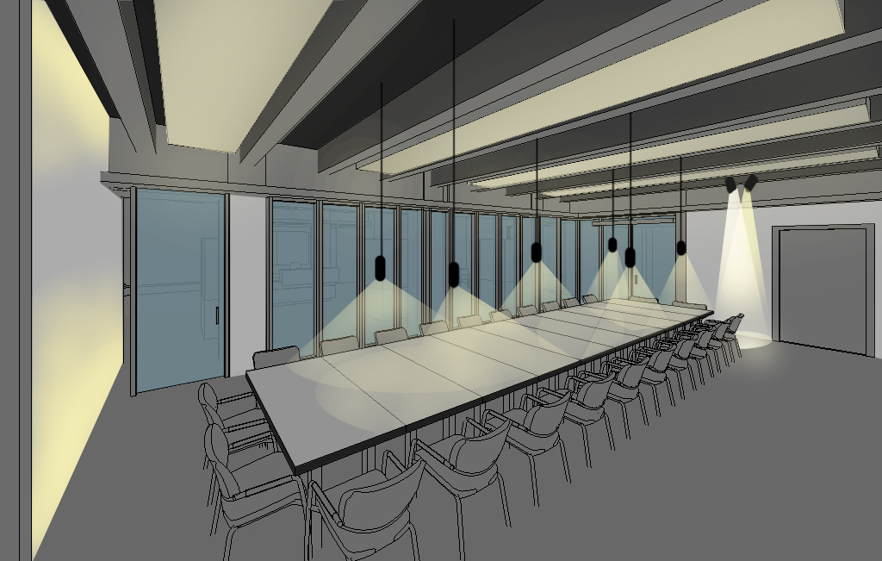
lobby | conference room | open office | façade
Conference Room
Fraunhofer CSE | Boston, MA | Schematic Design | Xiaoyin Wu

Slide 29
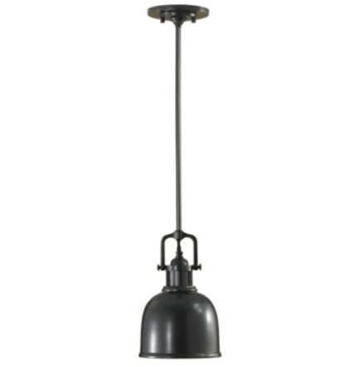
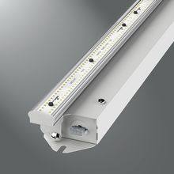
lobby | conference room | open office | façade
Conference Room
Fraunhofer CSE | Boston, MA | Schematic Design | Xiaoyin Wu

Slide 30
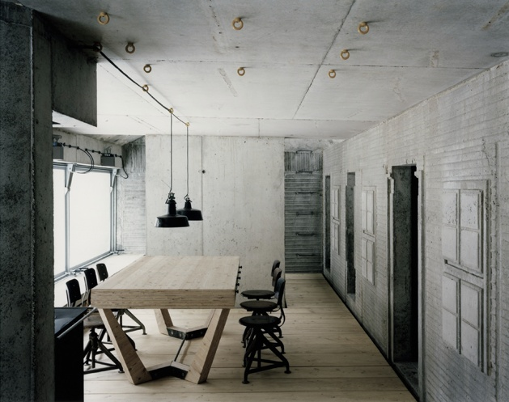
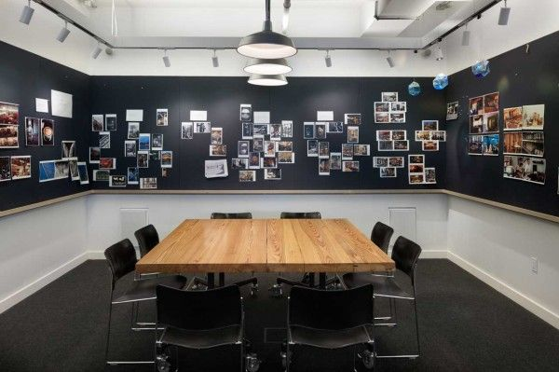
lobby | conference room | open office | façade
Conference Room
Fraunhofer CSE | Boston, MA | Schematic Design | Xiaoyin Wu

Slide 31
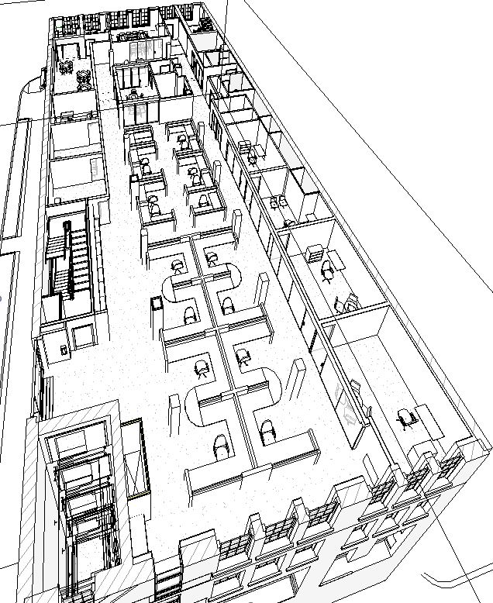
lobby | conference room | open office | façade
Open Office
Fraunhofer CSE | Boston, MA | Schematic Design | Xiaoyin Wu

Slide 32
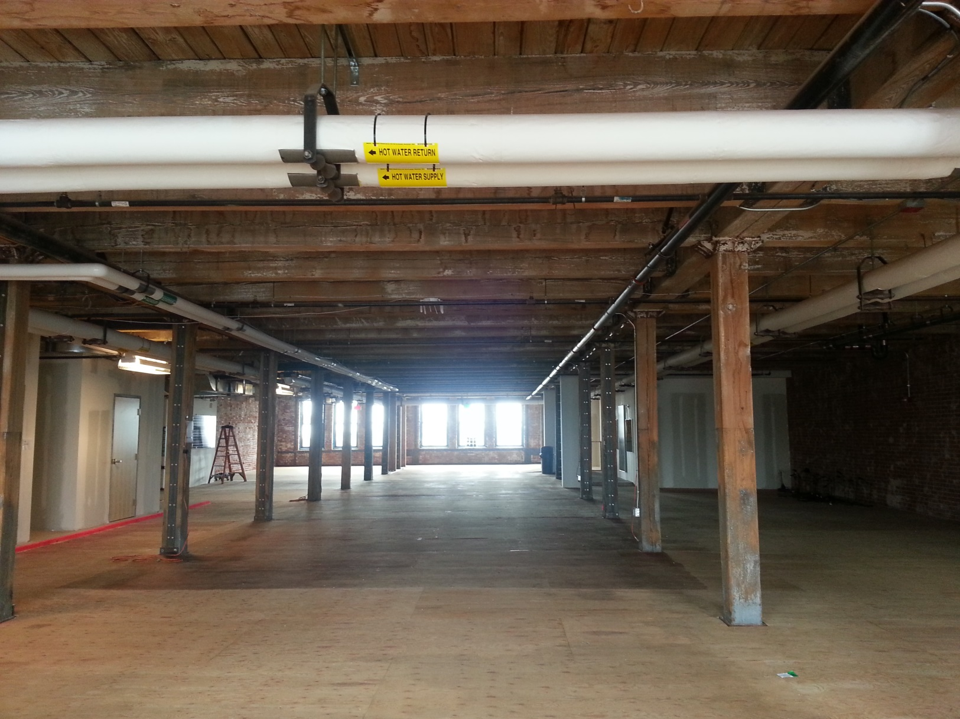
lobby | conference room | open office | façade
Open Office
Fraunhofer CSE | Boston, MA | Schematic Design | Xiaoyin Wu

Slide 33
lobby | conference room | open office | façade
Criteria
Surface/Purpose | Eh | Ev | Avg:Min
Work plane (computer) | 150 | 50 | 1.5:1
Clean
Modern
Spacious
Fraunhofer CSE | Boston, MA | Schematic Design | Xiaoyin Wu

Slide 34
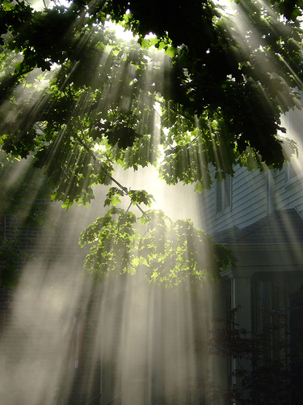
lobby | conference room | open office | façade
Open Office
Fraunhofer CSE | Boston, MA | Schematic Design | Xiaoyin Wu

Slide 35

lobby | conference room | open office | façade
Open Office
Fraunhofer CSE | Boston, MA | Schematic Design | Xiaoyin Wu

Slide 36
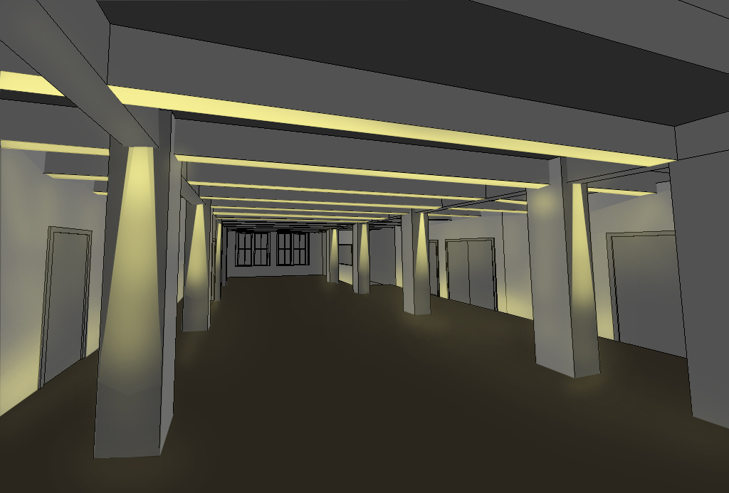
lobby | conference room | open office | façade
Open Office
Fraunhofer CSE | Boston, MA | Schematic Design | Xiaoyin Wu

Slide 37
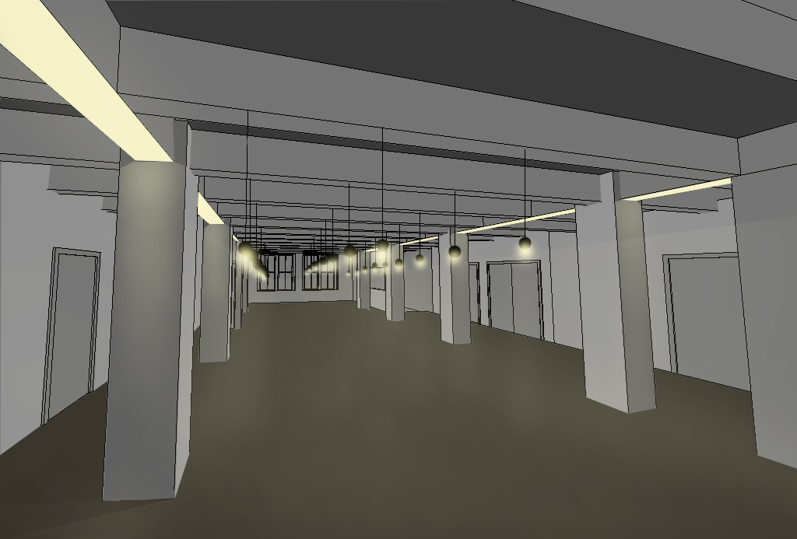
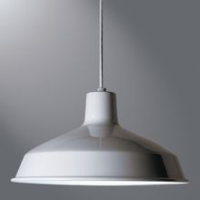
lobby | conference room | open office | façade
Open Office
Fraunhofer CSE | Boston, MA | Schematic Design | Xiaoyin Wu

Slide 38
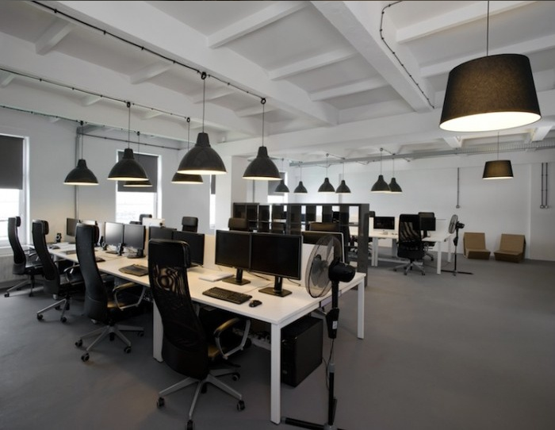
lobby | conference room | open office | façade
Open Office
Fraunhofer CSE | Boston, MA | Schematic Design | Xiaoyin Wu

Slide 39
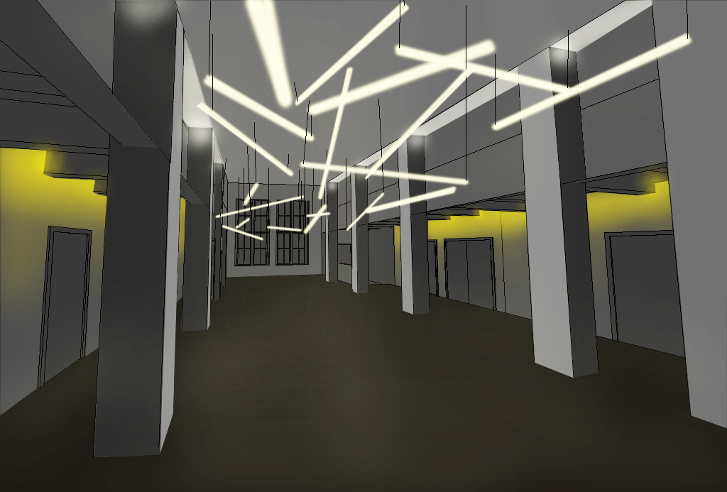
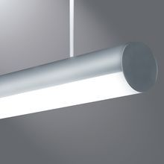
lobby | conference room | open office | façade
Open Office
Fraunhofer CSE | Boston, MA | Schematic Design | Xiaoyin Wu

Slide 40
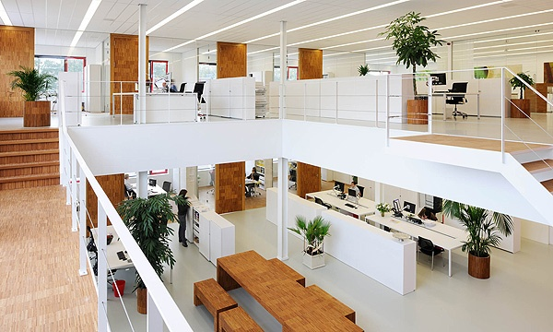
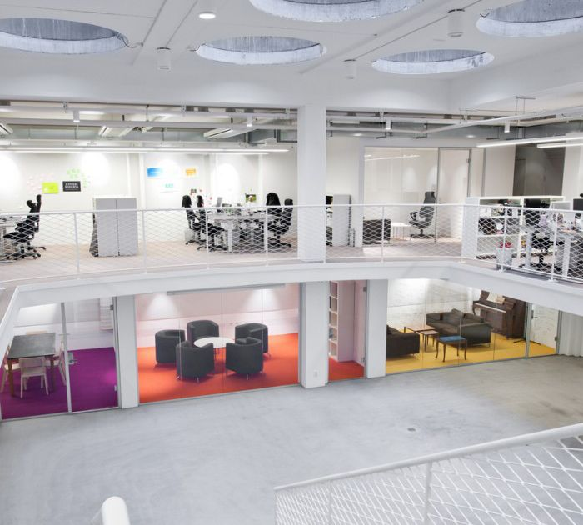
lobby | conference room | open office | façade
Open Office
Fraunhofer CSE | Boston, MA | Schematic Design | Xiaoyin Wu

Slide 41
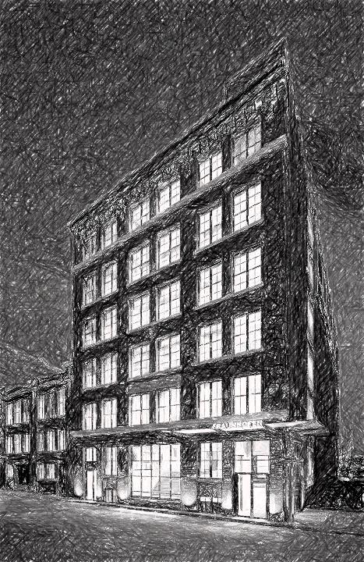
lobby | conference room | open office | façade
Façade
Fraunhofer CSE | Boston, MA | Schematic Design | Xiaoyin Wu

Slide 42
lobby | conference room | open office | façade
Criteria
IES Illuminance Recommendations
Façade with reflection<0.5 and low activity: Ev = 40 lux
ASHRAE 90.1 (2010) Requirements
Building entrances and exits: main entries = 20W/linear-ft of door width
Façade: 0.1W/sf for each illuminated wall or surface or 2.5 W/linear ft for each illuminated wall or surface length
Architectural Elements
Layers
Historical
Fraunhofer CSE | Boston, MA | Schematic Design | Xiaoyin Wu

Slide 43
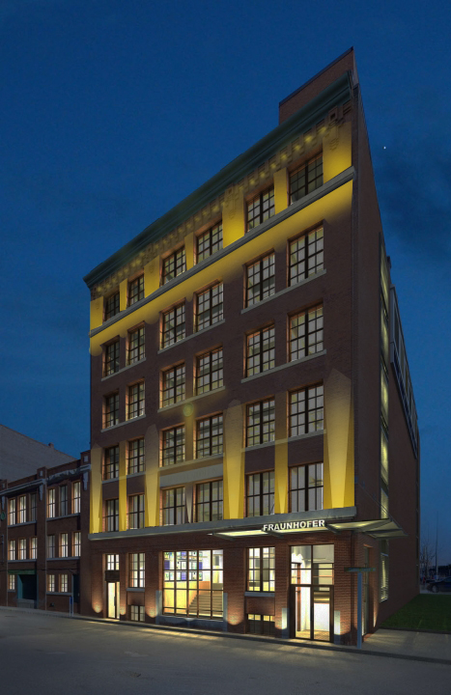
lobby | conference room | open office | façade
Façade
Fraunhofer CSE | Boston, MA | Schematic Design | Xiaoyin Wu

Slide 44
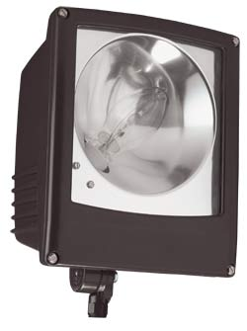
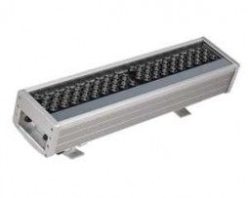
lobby | conference room | open office | façade
Façade
Fraunhofer CSE | Boston, MA | Schematic Design | Xiaoyin Wu

Slide 45
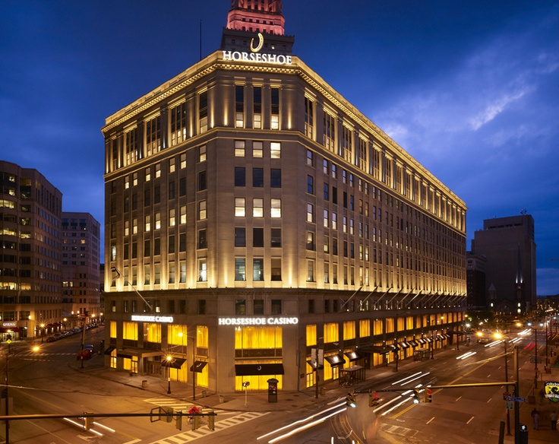
lobby | conference room | open office | façade
Façade
Horseshoe Casino, Cleveland
Fraunhofer CSE | Boston, MA | Schematic Design | Xiaoyin Wu

Slide 46
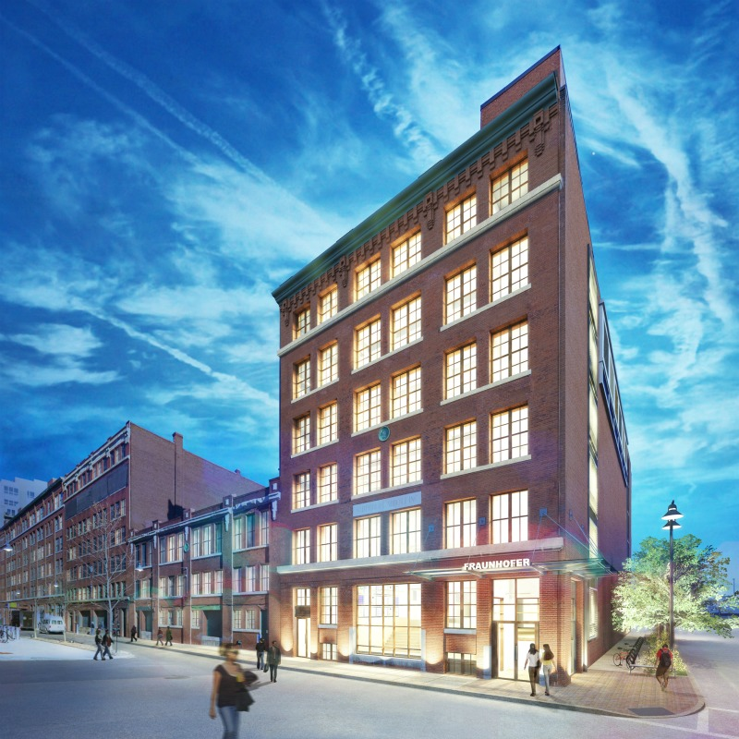
Fraunhofer | Center for Sustainable Energy
Boston, MA
Schematic Lighting Design
Xiaoyin Wu
2013.12.09
QUESTIONS?

